Slide 1


Full Stack Development with Java (ID-202B) Even Semester Session 2025-26
SMART FOOD ORDERING SYSTEMon
MANISH KUMAR SINGH (202410116100114 )
MANSI GARG (202410116100116)
MAYANK GOYAL (202410116100117)
Project Supervisor:
MS. DIVYA SINGHAL
Designation-Assistant Professor

Slide 2








Content
01
02
03
04
05
06
05
Future Scope

Slide 3
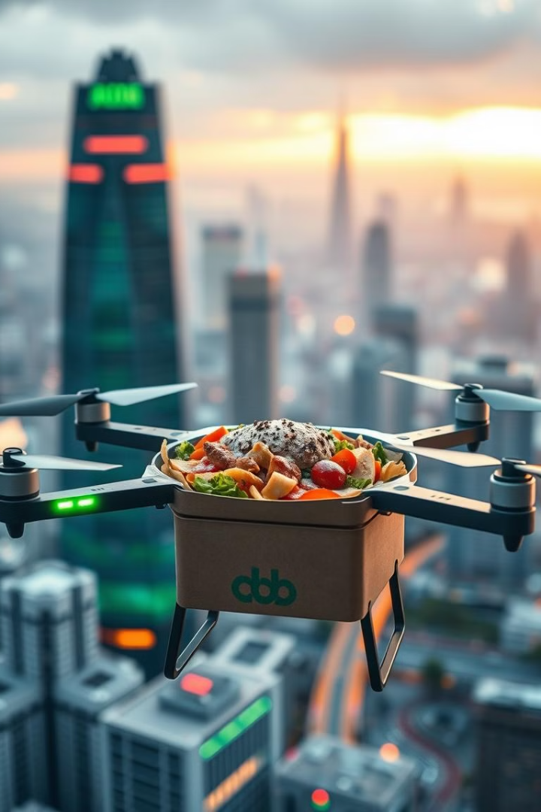
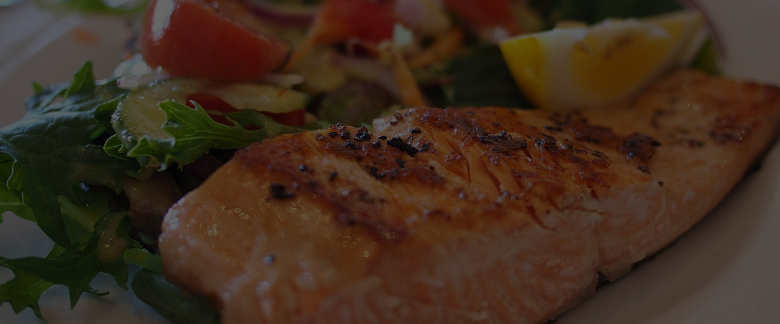
A digital platform that enables customers to browse menus, place orders, and make payments online or via an app.
Streamlines the ordering process for restaurants, cafes, and food delivery services.
Offers features like real-time order tracking, multiple payment options, and personalized recommendations.
Enhances customer convenience, reduces wait times, and improves business efficiency
24/7 chatbot support for queries & order tracking

Slide 4

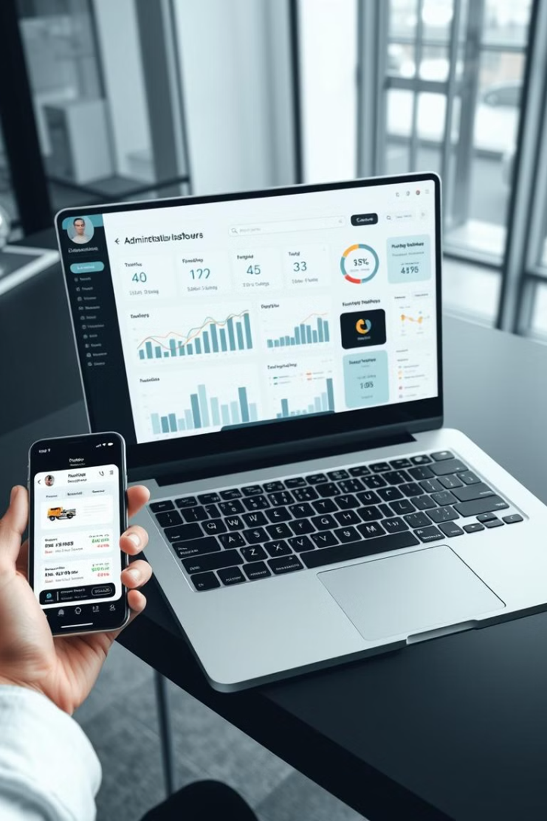

Traditional vs. Online Food Ordering
Traditional Methods
Walk-ins: Customers visit restaurants to order food.
Phone Orders: Customers call restaurants to place an order.
Evolution to Online Platforms
Web-based ordering: Early websites allowed users to browse menus and order online.
Mobile apps: Modern food delivery apps like Uber Eats, Zomato, and DoorDash provide faster, more convenient ordering.
Benefits of Online Food Ordering
Faster and more efficient than traditional methods.
Reduces human errors in order processing.
Enhances customer experience with real-time tracking and multiple payment options.

Slide 5
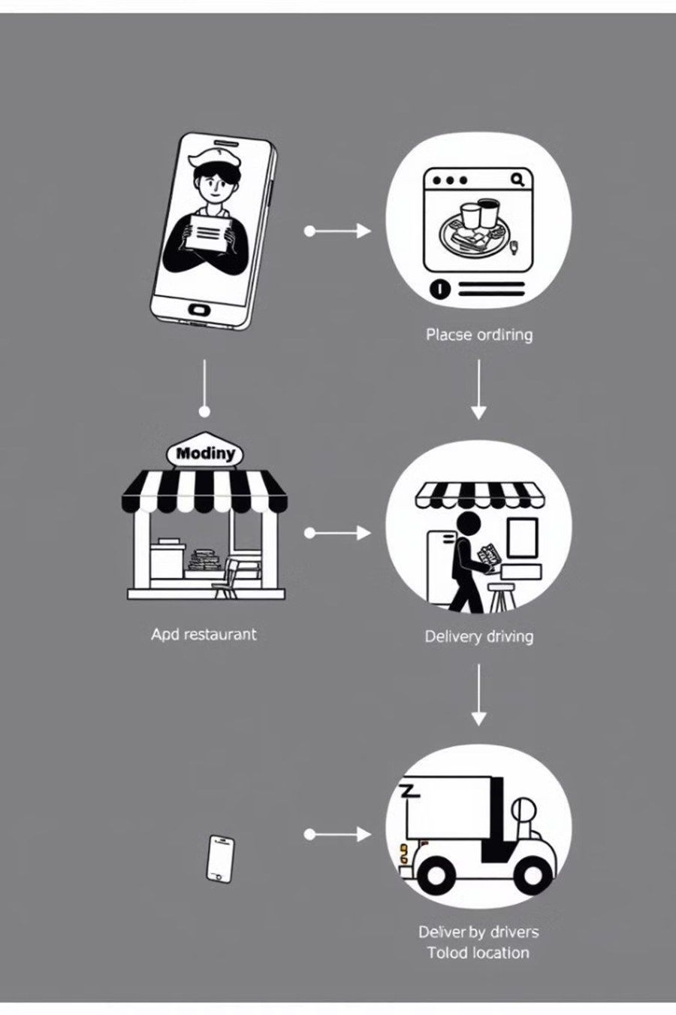
Research Findings & Challenges
Key Research Findings
Growth of Online Food Delivery Platforms
Online food ordering has rapidly increased, with many users preferring app-based ordering.
Customer Preferences and Trends
Customers value convenience, variety, fast delivery, and secure payments.
Challenges Faced by Food Delivery Services
High delivery costs – Maintaining affordable delivery prices is difficult.
Food quality concerns – Ensuring food remains fresh during delivery.
Peak-hour demand issues – Managing large numbers of orders at busy times

Slide 6

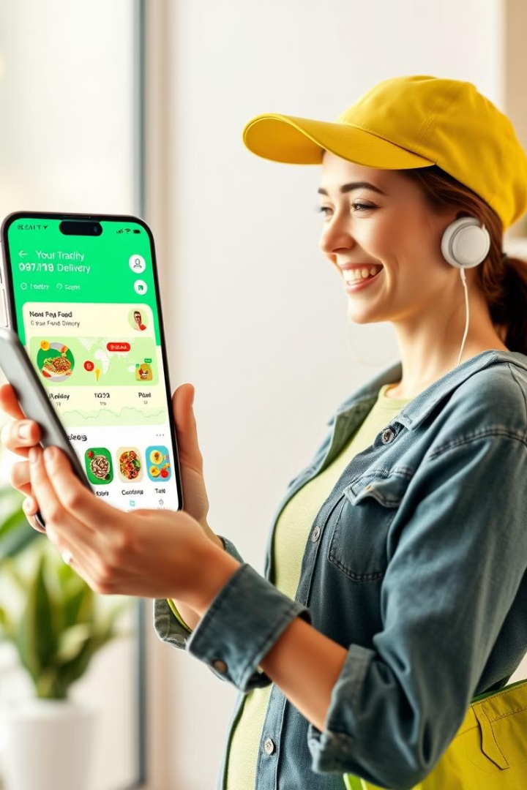
Benefits of Online Ordering
1
Accessibility
2
Accuracy
Increased accessibility and efficiency.
Reduction in human errors.
3
Experience
Enhanced customer experience with order tracking.

Slide 7
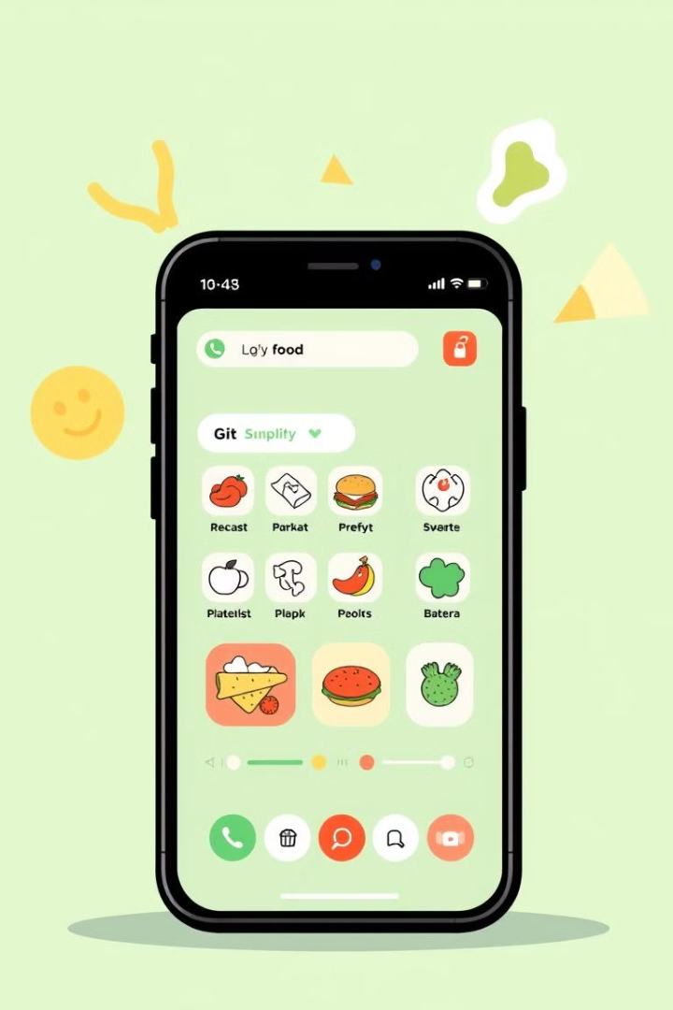
Project Objective
User-Friendly System
Streamline selecting, ordering, and paying for meals online.
Fast and Efficient
Ensure fast and efficient food ordering.
Secure Payment
Provide a secure payment gateway.
Restaurant Management
Enable owners to manage menu items and track orders.

Slide 8




Technology Stack
Frontend
Backend
Database
HTML, CSS, JavaScript, Bootstrap
Hypertext Preprocessor (PHP)
MySQL

Slide 9

Hardware Requirements
1
Development
4GB RAM, i3 Processor, 500GB Storage.
2
Server
Apache
3
Client
Mobile device or computer with internet access.

Slide 10








Software Requirements
Languages
Tools
Frameworks
HTML, CSS, JavaScript, PHP, SQL.
VS Code
Bootstrap, XAMPP

Slide 11
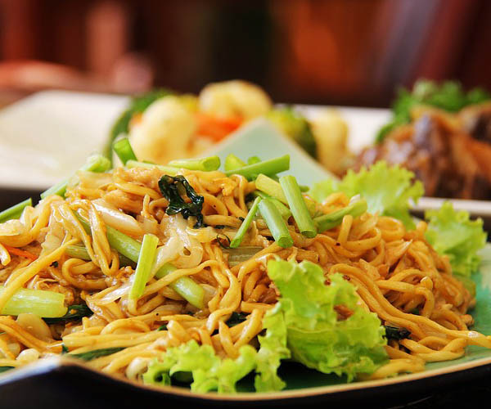





Modules
User Authentication
Menu Display and Chatbot
1
Signup, login, verification, role management.
Dynamic listing with filtering and search.
2
Order Tracking, Payment
4
Order Placement
Real-time status updates, Payment Gateway
3
Add to cart, secure checkout, order confirmation.

Slide 12
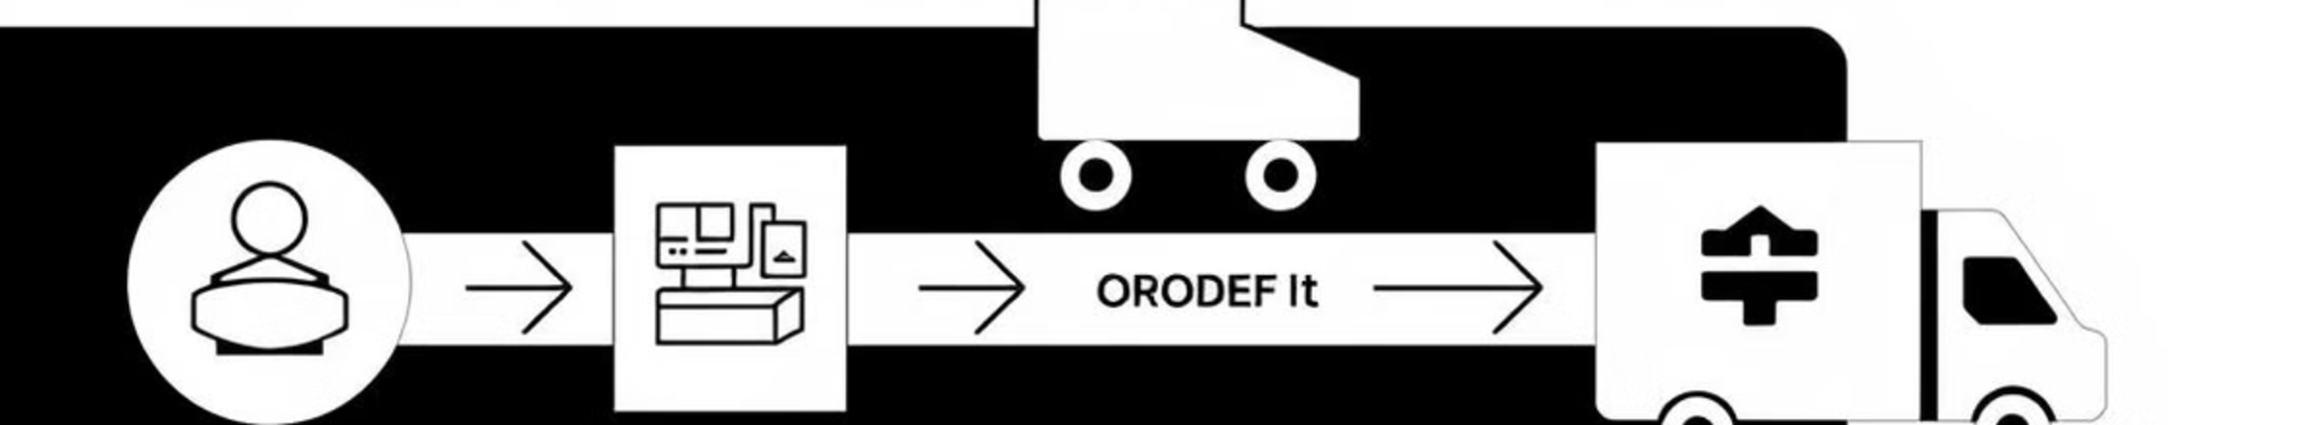

Workflow
User Login
1
User logs in/signs up.
.
Browse Menu
2
Selects food items.
Checkout
3
Adds items to cart and proceeds to checkout.
Payment
4
Completes payment, receives order confirmation, and food is delivered.

Slide 13
Future Scope
✔ AI-Powered Recommendations – Personalized food suggestions based on user preferences and past orders. ✔ Chatbot Integration – AI-driven virtual assistants for automated customer support and order placement. ✔ Voice-Activated Ordering – Hands-free ordering via Alexa, Google Assistant, and Siri. ✔ Drone & Autonomous Deliveries – Faster, contactless food delivery with smart technology. ✔ Subscription-Based Meal Plans – Customized daily/weekly meal plans for users.

Slide 14
Conclusion
Food ordering makes it easy to get meals anytime, anywhere.
Online apps and websites have made ordering food faster and more convenient.
Some challenges like late deliveries and food quality exist but are improving.
New technologies like smart recommendations and drone deliveries will make food ordering even better.
The food ordering industry will keep growing, making mealtime easier for everyone

Slide 15
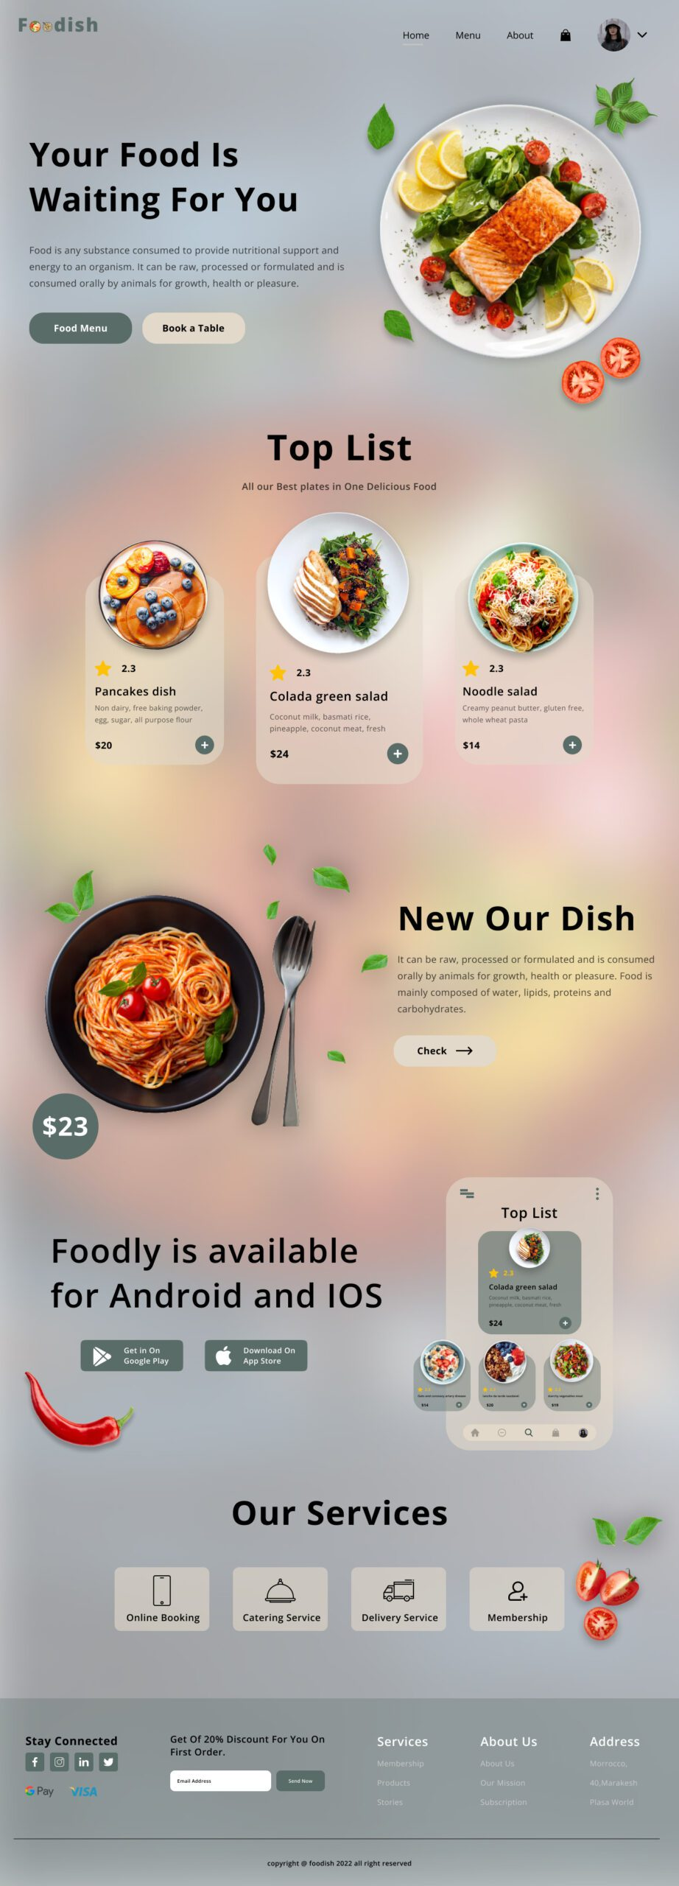
References
Research articles on online food ordering trends.
Smith, J. (2022). The Rise of Online Food Delivery Services: Trends and Challenges. Journal of E-Commerce, 15(3), 45-60.
Case studies on food delivery platforms.
Web sources on technology and framework selection.
Market Trends & Reports

